Slide 1
Personal Portfolio Website
Name : Tanvir Akter Sonia
ID:0812220105101068
DEPT:CSE
Batch:16(B)

Slide 2
What is a Personal Portfolio?
A digital collection that showcases an individual's skills, achievements, and projects
Often used by students, developers, designers, and creatives to highlight their work
Acts as an online resume or professional identity

Slide 3
Why is it Important in Today's Digital World?
Builds a strong personal brand and online presence
Helps employers and clients assess real skills and experiences
Makes it easier to share work and stand out in a competitive job market
Enables quick access to resume, contact info, and project links

Slide 4
Tools and Technologies Used
HTML
CSS
JavaScript
GitHub & GitHub Pages
VS Code (IDE)

Slide 5
Website Structure / Navigation
Home
About
Skills
Portfolio
Contact
CV
Social Media Links (FB, Instagram, LinkedIn)

Slide 6
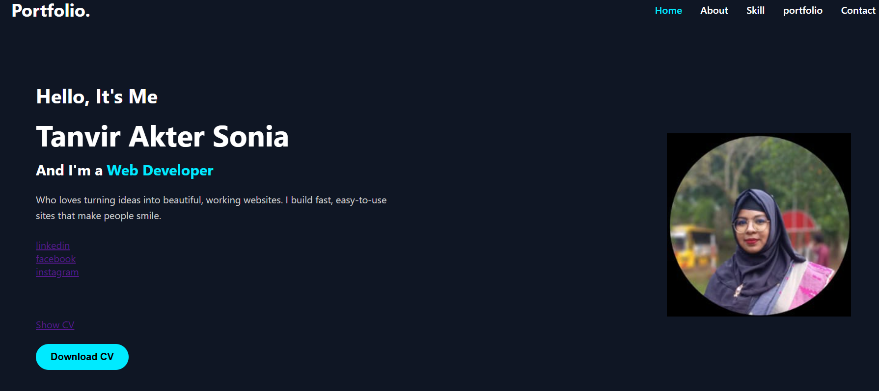
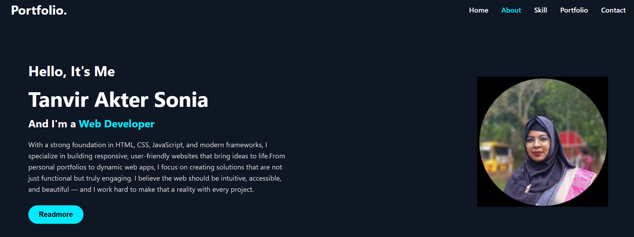
Home Page And About Page

Slide 7
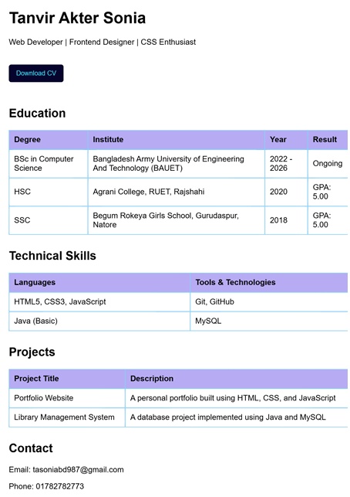
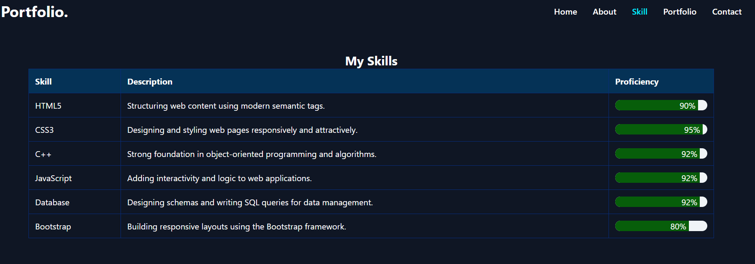
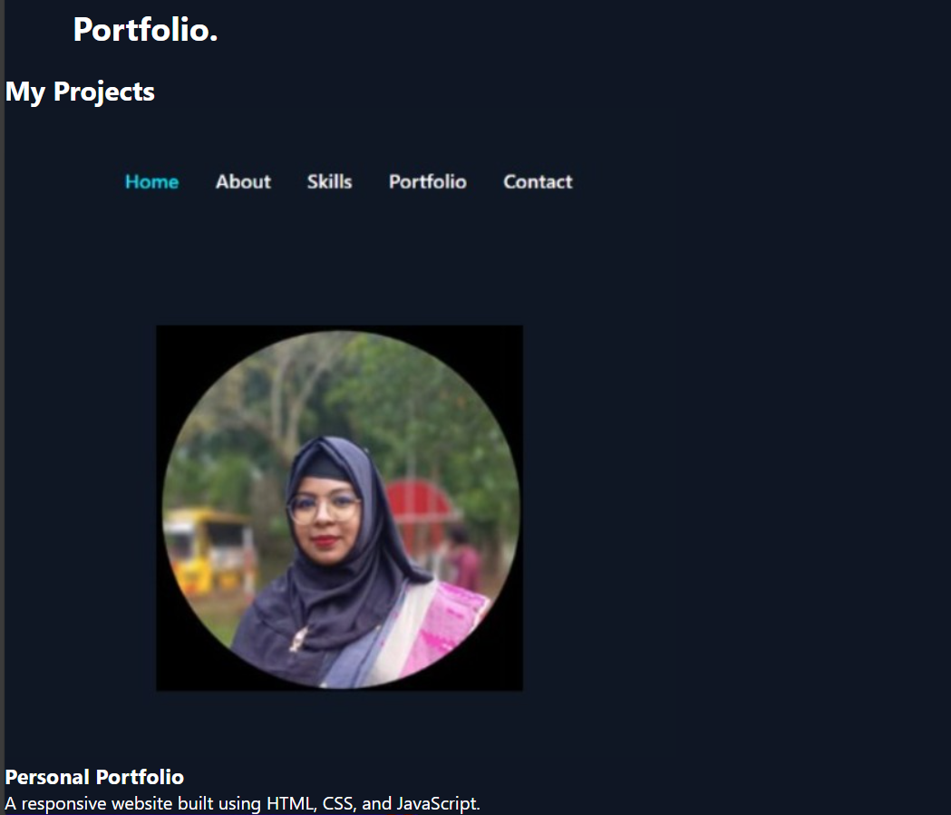
CV , Skill & Portfolio

Slide 8
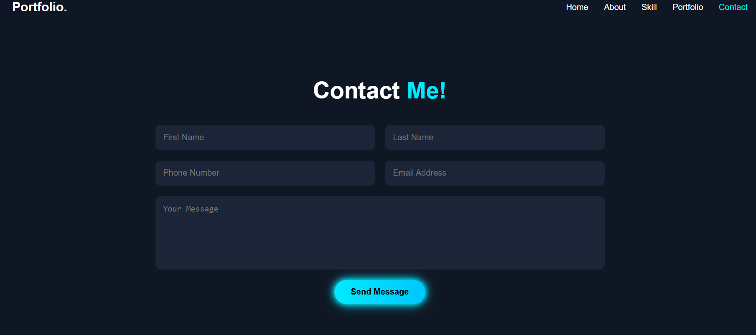
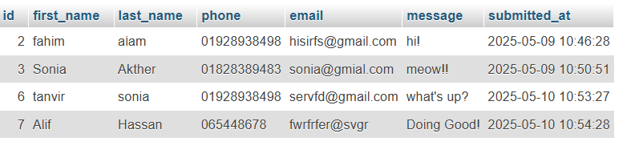
Contact & Connect Database!

Slide 9
Future Scope
Add blog section
Admin dashboard
Backend integration (Node.js/PHP)
Dark mode feature
Dynamic content update

Slide 10

"Your portfolio is your story — tell it with passion and purpose."

